Slide 1
Artificial Intelligence
Technical Introduction

Slide 2
Artificial Intelligence
Artificial Intelligence is the ability for machines to learn and understand Data, Events, Sensory Inputs without explicitly computing/programming. It is intelligence where machines mimics or excels human capacity to interact with the environment in an independent way without explicit instructions.
A general learning paradigm to mimic human’s ability, inspired by Animal/Human Brain

Slide 3
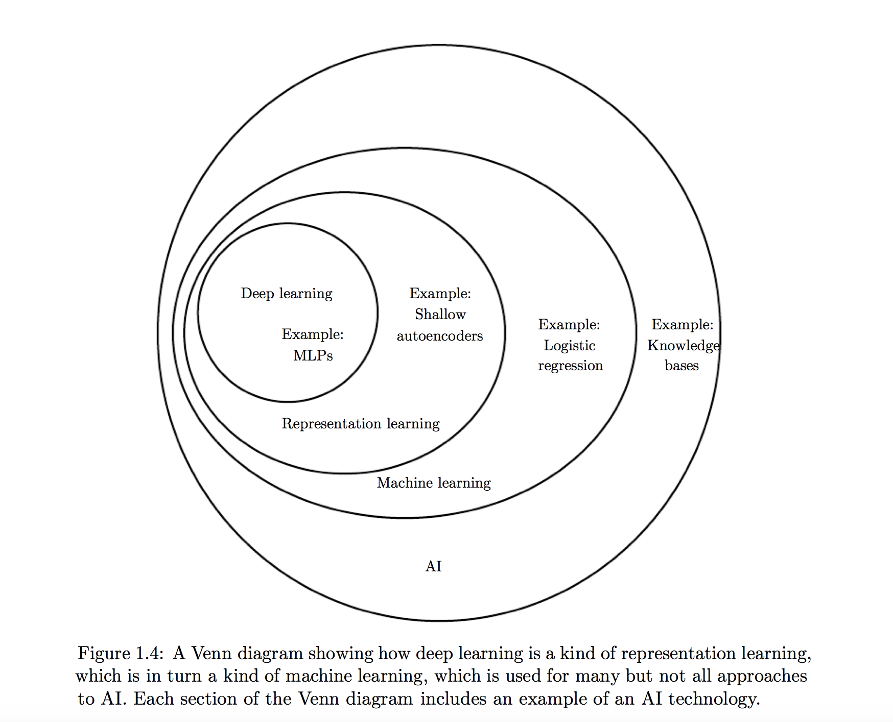

Slide 4
AI - > Deep Learning
Artificial Intelligence is the general term used to define Intelligent Systems
Deep Learning is a set of Algorithms that make Artificial Intelligent Systems

Slide 5
Deep Learning
It a deeply stacked layer of Neural Networks
Neural Networks are Biologically inspired.

Slide 6
Deep Learning
Notes:
Deep Learning
Biologically inspired by the brain and neurons
Deep Learning are stacked Layers of Neural Layers
Neural layers
https://en.wikipedia.org/wiki/Turing_test
Frank Rosenblatt’s Perceptron
http://psycnet.apa.org/index.cfm?fa=buy.optionToBuy&id=1959-09865-001
A psychologist, Rosenblatt conceived of the Percetron as a simplified mathematical model of how the neurons in our brains operate: it takes a set of binary inputs (nearby neurons), multiplies each input by a continuous valued weight (the synapse strength to each nearby neuron), and thresholds the sum of these weighted inputs to output a 1 if the sum is big enough and otherwise a 0 (in the same way neurons either fire or do not). Most of the inputs to a Perceptron are either some data or the output of another Perceptron, but an extra detail is that Perceptrons also have one special ‘bias’ input, which just has a value of 1 and basically ensures that more functions are computable with the same input by being able to offset the summed value. This model of the neuron built on the work of Warren McCulloch and Walter Pitts Mcculoch-Pitts
, who showed that a neuron model that sums binary inputs and outputs a 1 if the sum exceeds a certain threshold value, and otherwise outputs a 0, can model the basic OR/AND/NOT functions. This, in the early days of AI, was a big deal - the predominant thought at the time was that making computers able to perform formal logical reasoning would essentially solve AI
Biological motivation and connections
The basic computational unit of the brain is a neuron. Approximately 86 billion neurons can be found in the human nervous system and they are connected with approximately 10^14 - 10^15 synapses. The diagram below shows a cartoon drawing of a biological neuron (left) and a common mathematical model (right). Each neuron receives input signals from its dendrites and produces output signals along its (single) axon. The axon eventually branches out and connects via synapses to dendrites of other neurons. In the computational model of a neuron, the signals that travel along the axons (e.g. x0x0) interact multiplicatively (e.g. w0x0w0x0) with the dendrites of the other neuron based on the synaptic strength at that synapse (e.g. w0w0). The idea is that the synaptic strengths (the weights ww) are learnable and control the strength of influence (and its direction: excitory (positive weight) or inhibitory (negative weight)) of one neuron on another. In the basic model, the dendrites carry the signal to the cell body where they all get summed. If the final sum is above a certain threshold, the neuron can fire, sending a spike along its axon. In the computational model, we assume that the precise timings of the spikes do not matter, and that only the frequency of the firing communicates information. Based on this rate code interpretation, we model the firing rate of the neuron with an activation function ff, which represents the frequency of the spikes along the axon. Historically, a common choice of activation function is the sigmoid function σ, since it takes a real-valued input (the signal strength after the sum) and squashes it to range between 0 and 1. We will see details of these activation functions later in this section.

Slide 7
The Mark I Perceptron

Slide 8
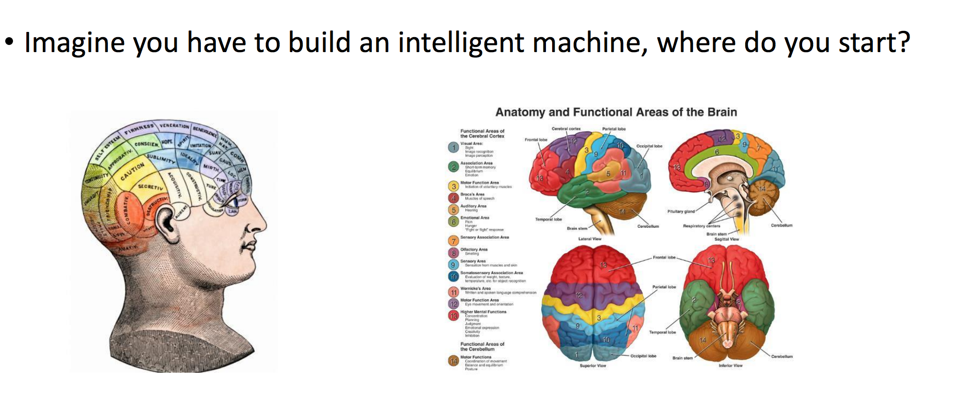
Brain Inspired – Intelligent Machines

Slide 9

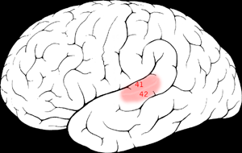

The “one learning algorithm” hypothesis
Auditory Cortex
Auditory cortex learns to see
[Roe et al., 1992]

Slide 10
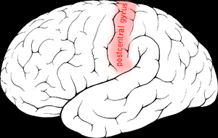

The “one learning algorithm” hypothesis
Somatosensory Cortex
Somatosensory cortex learns to see
[Metin & Frost, 1989]

Slide 11
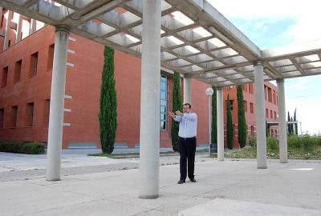
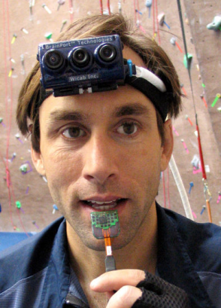
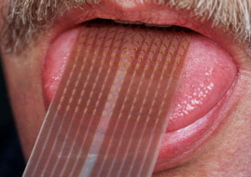
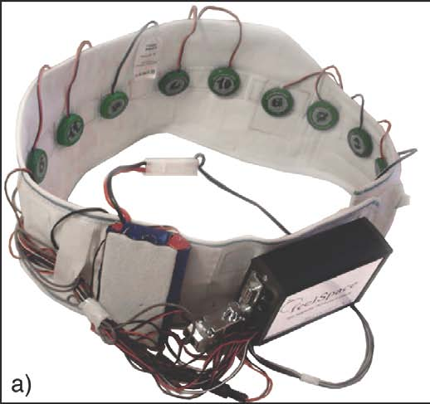
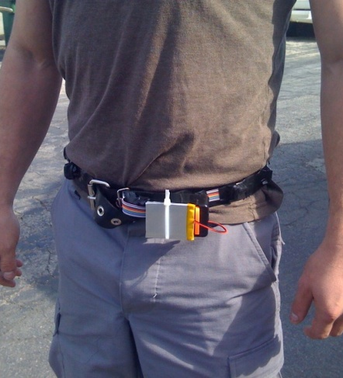
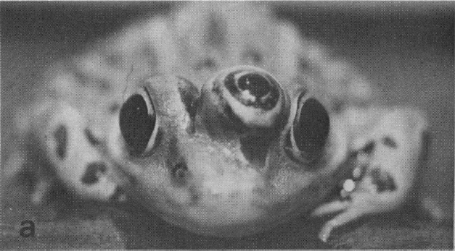
Sensor representations in the brain
Seeing with your tongue
Human echolocation (sonar)
Haptic belt: Direction sense
Implanting a 3rd eye
[BrainPort; Welsh & Blasch, 1997; Nagel et al., 2005; Constantine-Paton & Law, 2009]

Slide 12
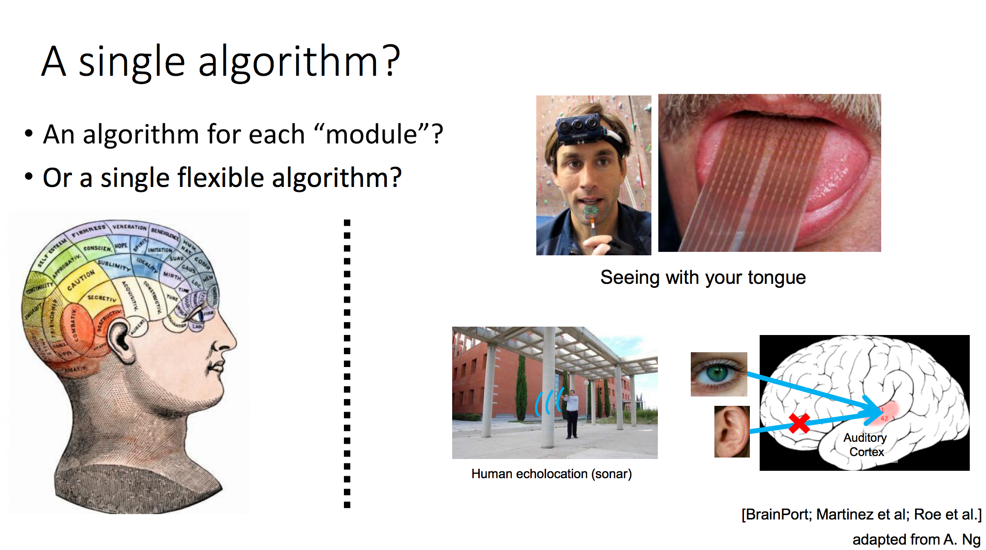
Single Learning Algorithms

Slide 13
Historical Perspective

Slide 14
History
Ref - http://beamandrew.github.io/deeplearning/2017/02/23/deep_learning_101_part1.html
Notes:
The idea of creating a ‘thinking’ machine is at least as old as modern computing, if not even older.
Alan Turing in his seminal paper ‘Computing Machinery and Intelligence’ laid out several criteria to asses whether a machine could be said be intelligent, which has since become known as the ‘Turing test’.
For some great explorations on variants of the Turing test, check-out Brain Christian’s book detailing his adventures with the Loebner Prize entitled The Most Human Human or check the amazing, dramatized version in Ex-machina.
Alan Turing[edit]
Researchers in the United Kingdom had been exploring "machine intelligence" for up to ten years prior to the founding of the field of artificial intelligence (AI) research in 1956.^{[14]} It was a common topic among the members of the Ratio Club, who were an informal group of British cybernetics and electronics researchers that included Alan Turing, after whom the test is named.^{[15]}
Turing, in particular, had been tackling the notion of machine intelligence since at least 1941^{[16]} and one of the earliest-known mentions of "computer intelligence" was made by him in 1947.^{[17]} In Turing's report, "Intelligent Machinery",^{[18]} he investigated "the question of whether or not it is possible for machinery to show intelligent behaviour"^{[19]} and, as part of that investigation, proposed what may be considered the forerunner to his later tests:
Minsky
Along with the double-PhD wielding Seymor Papert, Minksy wrote a book entitled Perceptrons that effectively killed the perceptron, ending embryonic idea of a neural net. They showed that the perceptron was incapable of learning the simple exclusive-or (XOR) function. Worse, they proved that it was theoretically impossible for it to learn such a function, no matter how long you let it train. Now this isn’t surprising to us, as the model implied by the perceptron is a linear one and the XOR function is nonlinear, but at the time this was enough to kill all research on neural nets and usher in the first AI winter.
Geoffery Hinton George Bool’s great-great-grandson, a man by the name of Geoff Hinton, finished his PhD studying neural networks in 1978 and by 1986 had moved to the institute for cognitive science at UC San Diego. Along with David Rumelhart and Ronald Williams, Hinton published a paper entitled “Learning representations by back-propagating errors”.
The algorithm works by taking the derivative of the network’s loss function and back-propagating the errors to update the parameters in the lower layers, hence the common moniker backprop. Though Rumelhart, Hinton and Williams are often credited for inventing backprop, this is disputed by some. There is something of a long standing controversy between the deep learning “conspiracy” of Geoff Hinton /Yann Lecun/Yoshua Bengio and Jürgen Schmidhuber as to who should actually be credited with several key developments, but that’s an issue best left tabled for now.
This algorithm lead to some early successes, notably in training convoluational neural nets (aka CNNs, also referred to using the less pronounceable convnets) to recognize handwritten digits, a project which was speared headed by Yann Lecun at AT&T Bell Labs.
Geoff Hinton on Deep Learning (Interesting video on challenges he faced)
https://www.youtube.com/watch?v=uAu3jQWaN6E
Around 2006, Hinton once again declared that he knew how the brain works, and introduced the idea of unsupervised pretraining and deep belief nets

Slide 15
Modern Success
2006 - The idea was to train a simple 2-layer unsupervised model like a restricted boltzman machine, freeze all the parameters, stick on a new layer on top and train just the parameters for the new layer. – Geoff Hinton.
2012 – Alex Krizhevsky, Ilya Sutskever, and Geoff Hinton entered a submission that would halve the existing error rate to 16%
Notes:
You would keep adding and training layers in this greedy fashion until you had a deep network, and then use the result of this process to initialize the parameters of a traditional neural network.
Using this strategy, people were able to train networks that were deeper than previous attempts, prompting a rebranding of ‘neural networks’ to ‘deep learning’
In 2010, a large database known as Imagenet containing millions of labeled images was created and published by Fei-Fei Li’s group at Stanford
In the first two years of the contest, the top models had error rates of 28% and 26%. In 2012, Alex Krizhevsky, Ilya Sutskever, and Geoff Hinton entered a submission that would halve the existing error rate to 16%. The model combined several critical components that would go one to become mainstays in deep learning models.
Interesting lecture by Yann LeCunnss
https://www.bell-labs.com/var/articles/yann-lecun-predictive-learning-next-frontier-ai-february-17-2017/

Slide 16
Modern Success

Slide 17
ILSRVC – Imagenet
Notes:
http://www.image-net.org/

Slide 18
Reasons for Success
Vast amounts of Data
GPUs
Google’s Famous cat experiment
Took $1 million in 2013
$20,000 GPU
*There is a big race in the Chip Market to get better CPUs
Faster Back Propagation
Better Activation Functions
RELU vs Sigmoid

